Slide 1








Hkbk College of engineering
department of Computer science and engineering
internship 18csi85
27-05-2024
Machine learning with python
“Machine Learning Algorithms for Predicting the Risks of Chronic Diseases”
Varcons Technologies pvt. ltd.
Internship carried out at:
Presented by
Santosh Kumar Paital
1HK20CS143
8 SEM 'C'
Under the Guidance,
Prof. Sri Lakshmi P. (Asst. Professor)
DR. Deepak N R (Professor)
Dept. of CSE, HKBKCE

Slide 2


company Profile
About project
Technical Description
History of Company.
Services Provided by Company.
Project Assigned.
Introduction about Project.
Environment.
System requirements,
environment setup,
implementation of the
system.
Contents
screenshots
outcomes
design & analysis
Output of the project
with F1 score,
interface and result.
coding and testiong
tarining of model.
outcomes of training.
Implementing with
design analysis
and algorithms.

Slide 3

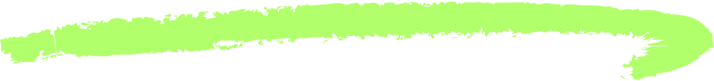
company profile
Varcons Technologies Pvt. Ltd.
Founded by visionary friends, Varcons Technologies evolved into a leading provider of innovative technologies and services.
Offers scalable solutions including SaaS products, Corporate Seminars, Industrial trainings, and more.
Expertise spans web design, MYSQL, PYTHON Programming, HTML, CSS, ASP.NET, and LINQ.
Specializes in ERP, Connectivity, SEO Services, Conference Management, and tailored software products.
Based in Bangalore, India, Varcons Technologies focuses on creativity and innovation in software development.
Emphasizes understanding client demands and adapting solutions accordingly.
Positioned as an IT solutions consulting group, Varcons Technologies leverages technology for business scalability, efficiency, and customer delight.

Slide 4
company profile
Services provided by Varcons Technologies.:
Core Java and Advanced Java
Research and Development/Improvise of ML Models
Web services and development
Dot Net Framework
Python
Selenium Testing
Conference / Event Management Service
Academic Project Guidance
On The Job Training
Software Training

Slide 5

Introduction
Machine Learning (ML) is a subset of artificial intelligence (AI) focused on algorithms and statistical models for autonomous task performance.
ML algorithms learn from historical data, predict outcomes, identify patterns, and automate decision making processes.
Applications of ML are widespread, spanning healthcare, finance, marketing, autonomous vehicles, and more.
Abundant and diverse career opportunities exist within Machine Learning, including roles such as Machine Learning Engineer, Data Scientist, AI Researcher, and ML Product Manager.
Industries actively seeking ML expertise include healthcare, finance, ecommerce, and technology.
Machine Learning offers exciting career prospects across various sectors due to its capacity to innovate and streamline processes.

Slide 6
training
Comprehensive training in Python programming language.
Specialized courses in machine learning algorithms.
Hands on workshops on data analysis and visualization with Python.
Advanced training in artificial intelligence and deep learning techniques.
Tailored programs covering various aspects of software development and deployment.
Practical sessions on implementing machine learning models in real world scenarios.
Expert guidance on understanding and applying Python libraries for data manipulation and analysis.
Personalized mentorship to enhance proficiency in machine learning algorithms and techniques.
Varcons Technologies provides cutting edge training programs designed to equip participants with the skills and knowledge necessary to excel in Python programming and machine learning algorithms.

Slide 7
about project
Project Assigned
Problem Statement:
Machine Learning algorithms for predicting the risks of chronic diseases-You can use the
already working model, learn the working of the model, test the working of the model, and try
to improve the overall accuracy of the model Current accuracy rate: 68/100
“Chronic diseases demand proactive management, requiring accurate risk assessment.”
System: Utilizing ML to predict risks based on diverse datasets including demographics and symptoms.
Aim: Revolutionize healthcare by accurately predicting chronic disease risks.
Challenges: Handling missing data, ensuring model accuracy, and integrating into healthcare.
Goal: Empower healthcare with accurate risk identification for proactive management.

Slide 8


technical description
Hardware
Software
CPU: Intel Core or Xeon 3GHz
(or Dual Core 2GHz) or equal AMDCPU
Cores:Single
(Dual/Quad Quad Core is recommended)
RAM: 4 GB (6 GB recommended)
Display Resolution: 1280×1024 is recommended, 1024×768 is minimum
Front End: Python ,Gradio,Joblib
Back End: Machine Learning With Python Tools: Jupyter notebook, Google collab, VS code
Windows 7
(64-bit, Professional level or higher)
Mac OS X 10.5.1+
Ubuntu 9.10 (64bit)
Ubuntu 8.04 (32bit/64bit)
NumPy and pandas for data manipulation.
Scikit-learn for machine learning algorithms.
TensorFlow or PyTorch for deep learning.
Matplotlib and Seaborn for data visualization
libraries
operating system

Slide 9






Data Collection
Gather data from reliable sources. e medical records, surveys, electronic health records, or publicly available datasets like NHANES, CDC, etc.
Design & Analysis
Data Processing
Handle missing Data, Data Cleaning, Normalization, Data Spliting with 70% training, 15% validation, 15% testing
Model Training & Testing
Build a machine learning model to predict the disease in individuals based on health-related attributes like symptoms.
Develop a user-friendly predictive system for real-world applications in healthcare.
Model Selection (DECISION TREE),
fine tunning hyperparameters, Evaluation of F1 score, accuracy, confusion Matrix
Predictive System
User Friendly predictive system,
standardization, accurate Decision making.

Slide 10
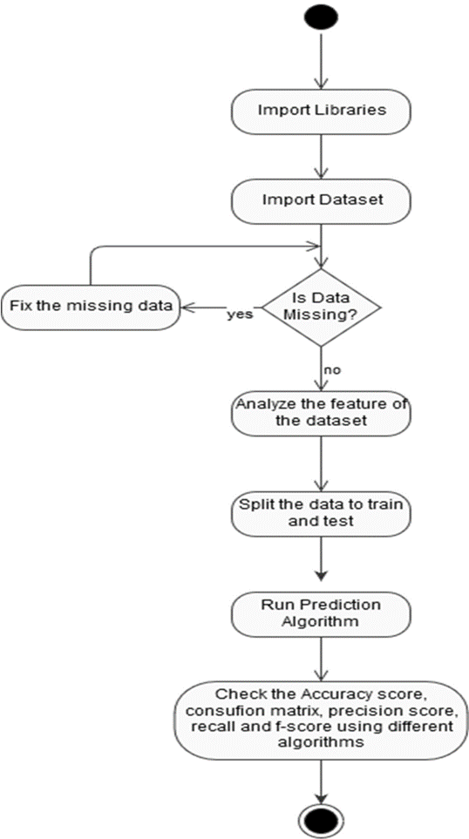
Design & Analysis
Activity Diagram
Activity diagrams are crucial in ML projects as they visualize workflows, identify task dependencies, improve communication, ensure completeness, facilitate debugging and optimization, support agile methodologies, and enhance team collaboration.

Slide 11
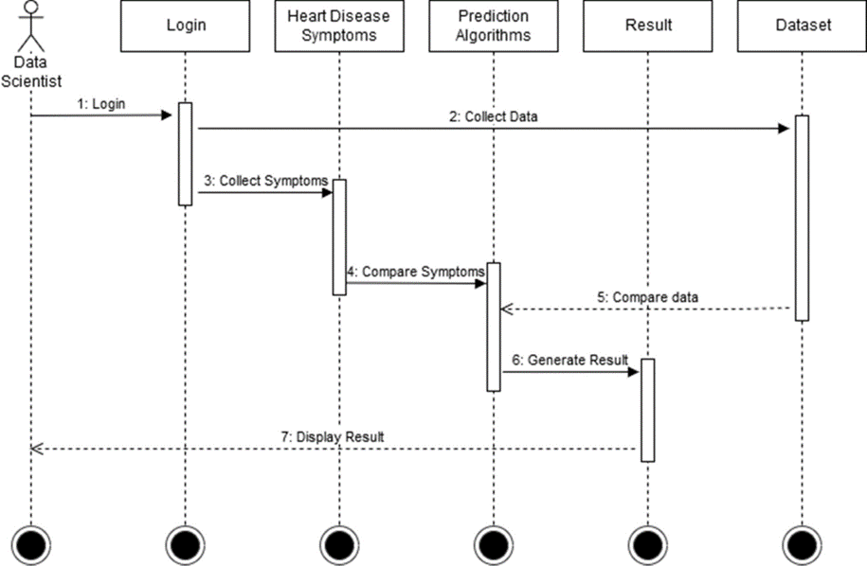
Design & Analysis
Sequence Diagram for Future Scope
Sequence diagrams are crucial for future scope in ML projects as they model interactions between system components, clarify system behavior, identify potential improvements, enhance documentation, support scalability planning, facilitate stakeholder communication, and provide a blueprint for future development and integration.

Slide 12





outcomes
The initial system is adapted linear regression with 68% accuracy, which failed to give accurate decision
98%
New model is developed with Decision tree among the SVM and Gradio interface to give 98% maximization Accuracy.
(70% training, 15% validation, 15% testing)
68%

Slide 13

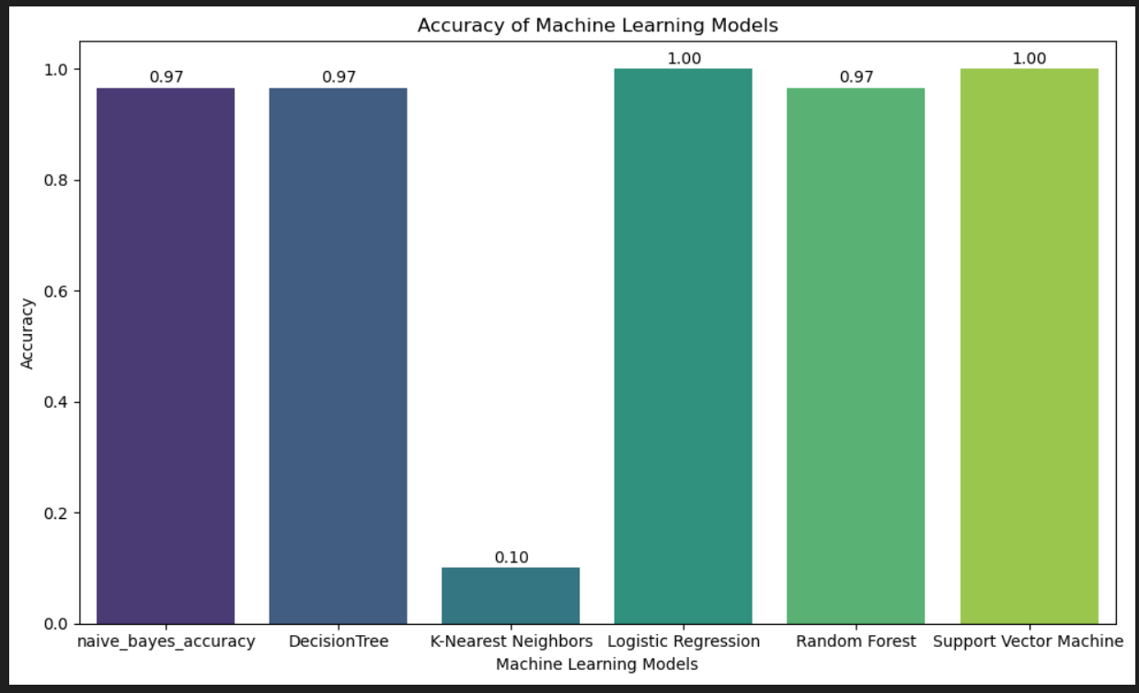
Result Screenshots
01
Decision Tree Accuracy 97%
implemented of better classification, regression, feature selection.
02
SVM (Support vector Machine)
outlier detection, complex data distribution with 100%
03
Naive bayes for bayes condition with 97% and Random Forest for multitude of Decision Tree to make out of DT with 97% Accuracy.

Slide 14

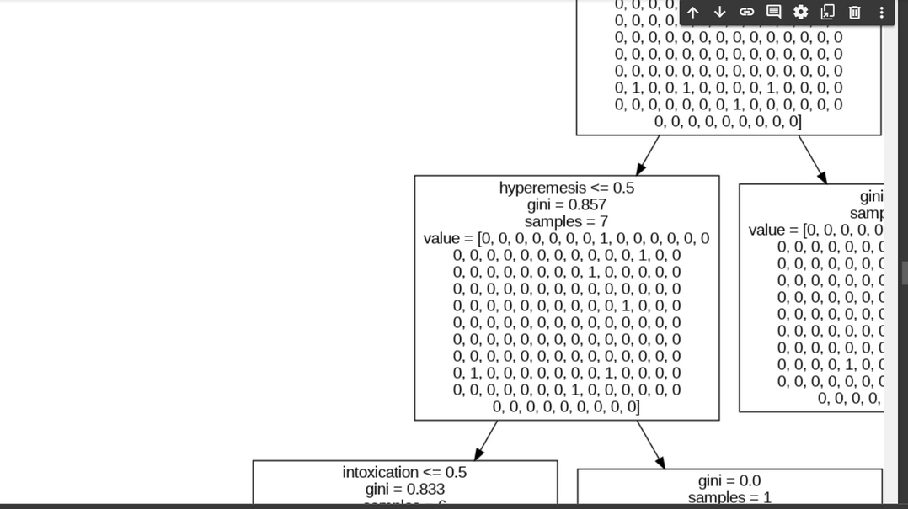
Result Screenshots
Decision tree
Decision Tree Accuracy 97%, Decision trees are versatile tools used for classification, regression, feature selection, interpretability, and as base learners in ensemble methods.

Slide 15
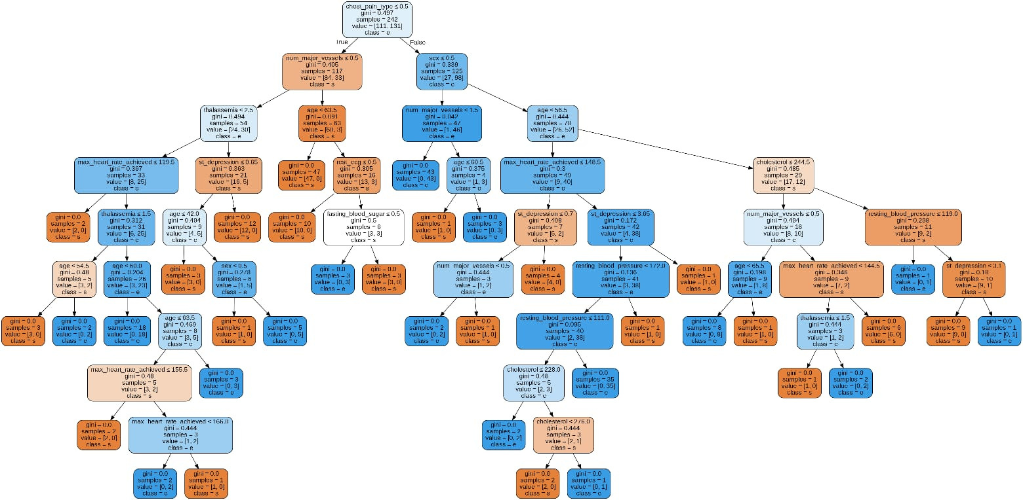
Result Screenshots
Decision tree
Decision Tree with particular disease scenario based plotted .
For Example : Heart Disease

Slide 16
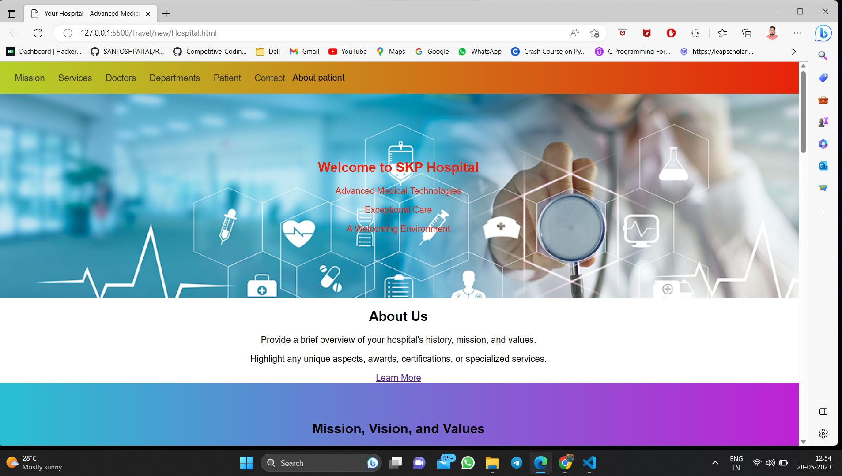
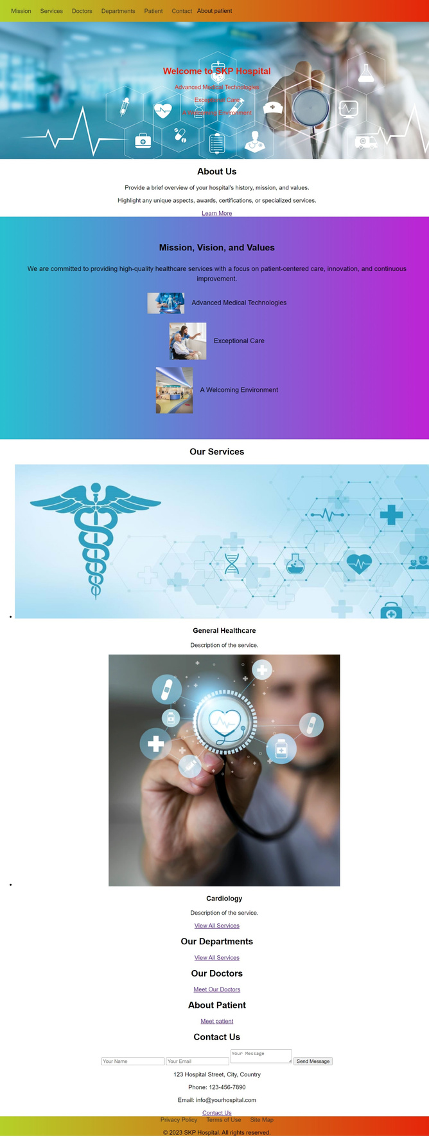




interface
[ NOTE: This app is meant for demo purposesonly. Please consulta Doctor if you have any symptoms.]

Slide 17
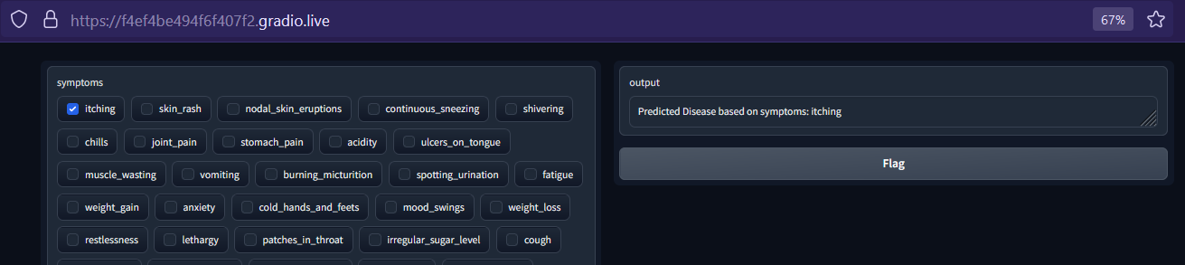
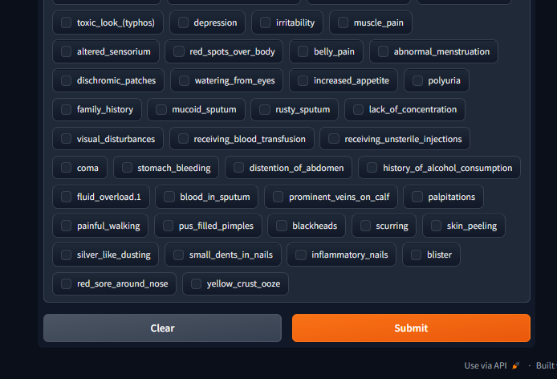
Screenshots
interface
Gradio API facilitates the creation of a user-friendly interface where users can input symptoms, triggering machinelearning models to predict diseases, streamlining the diagnostic process and enhancing accessibility to healthcare information.
[ NOTE: This app is meant for demo purposes only. Please consult a Doctor if you have any symptoms.]

Slide 18
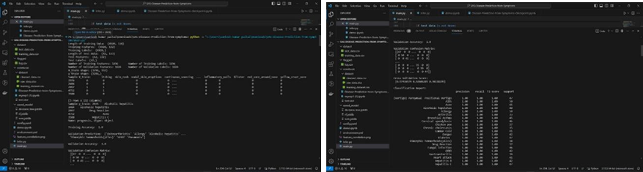
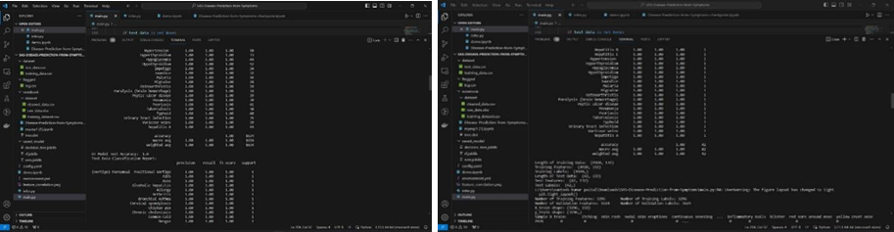
Screenshots
Testing
Facilitated with various model training, F1 score , Confusion Matrix,
report of scores and accuracy of the optimized model performance.

Slide 19
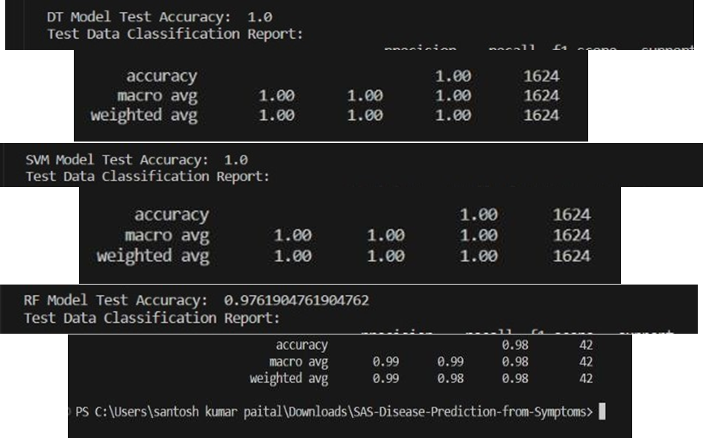
Screenshots
accuracy report
Visualization of various machine learning model implementations alongside their respective accuracy reports provides a comprehensive overview of performance differences, aiding in informed decision- making for model selection and optimization.
DT 1.0, SVM 1.0, RF 0.98

Slide 20

Presented by,
Santosh Kumar Paital
thank you
“Prevention is better than cure”

